Slide 1

STAMPCORE INDIA PVT. LTD.
L-109 , Near POSCO Steel Center ,
Taloja M.I.D.C
Navi Mumbai Pin -410 208.
Maharashtra
Tel : 9321252487
Email : infostampcore@gmail.com

Slide 2
Company Profile
Nature of Business: Manufacturer & Supplier
Specialized in CRGO Transformer Laminations
Focused on quality, precision, and timely delivery
Serving transformer and electrical industries
Located in India with advanced manufacturing support

Slide 3
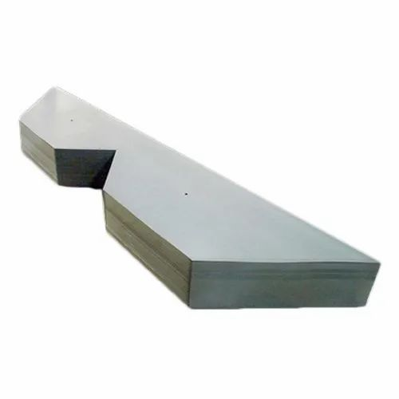
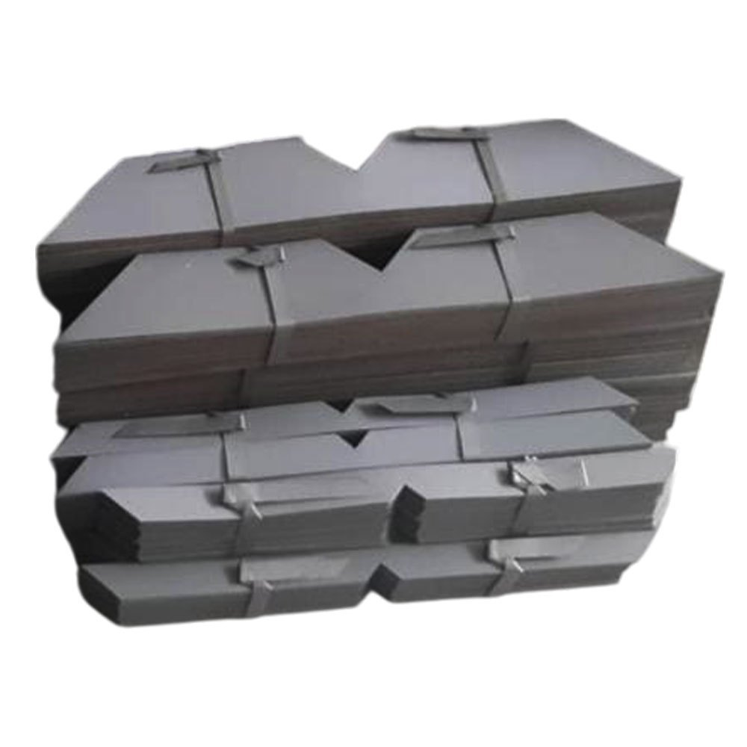
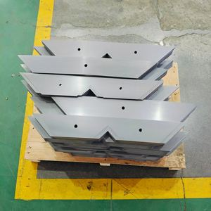
About CRGO Transformer Laminations
CRGO stands for Cold Rolled Grain Oriented Steel
Used in transformer core manufacturing
Provides low core loss and high magnetic permeability
Improves transformer efficiency and performance
Available in various grades and thicknesses

Slide 4
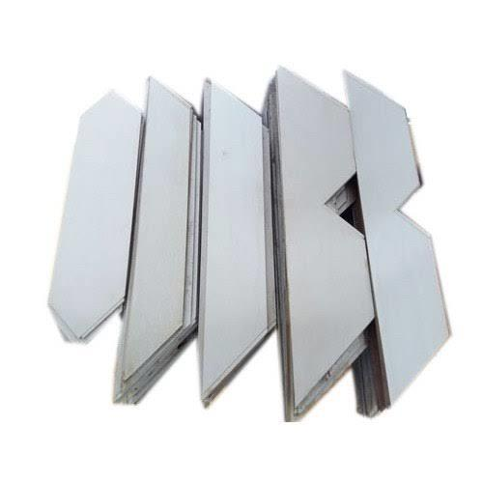
Our Product Range
CRGO EI Laminations
Step Lap Transformer Core Laminations
Distribution Transformer Core
Power Transformer Core
Customized Transformer Lamination Solutions

Slide 5
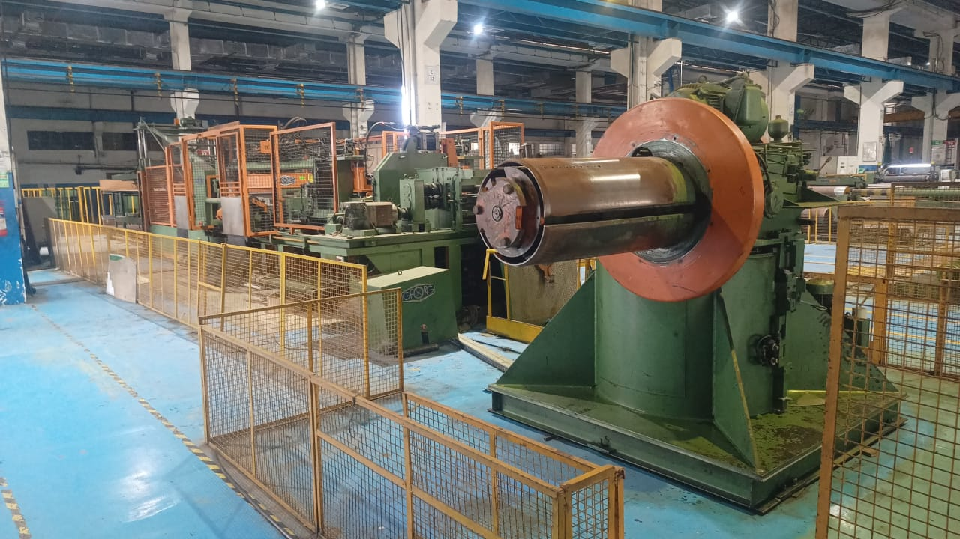
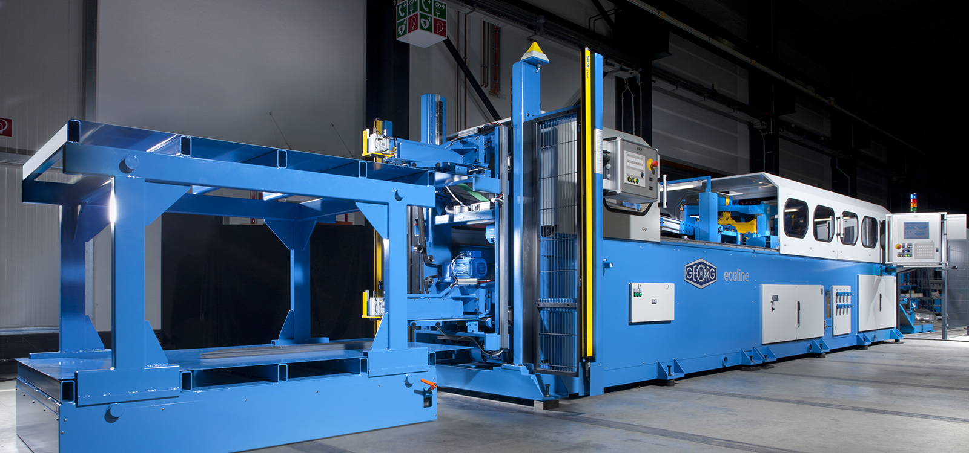
Manufacturing Facilities
Precision cutting and slitting machines
High-quality inspection systems
Skilled workforce and technical support
Strict quality control process
Efficient production and packaging system

Slide 6
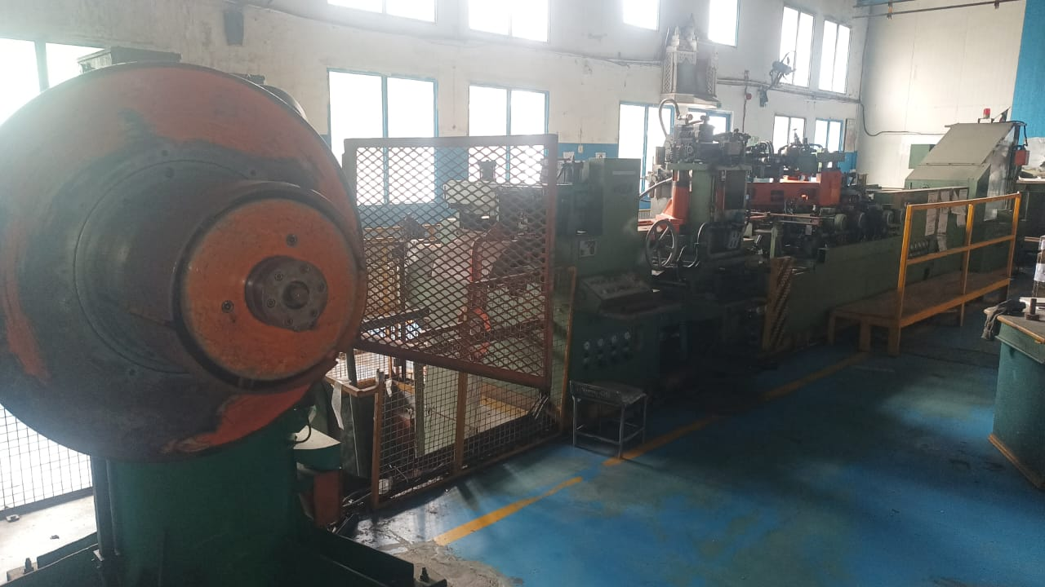

Slide 7
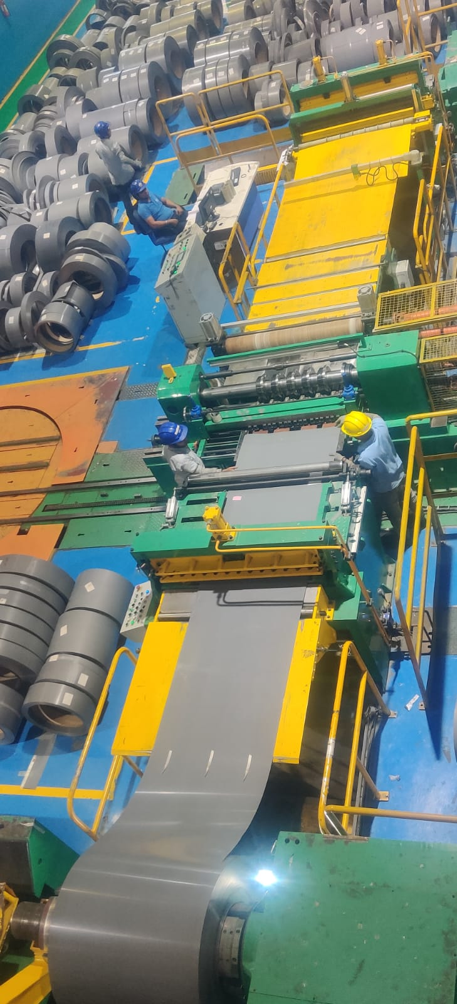

Slide 8
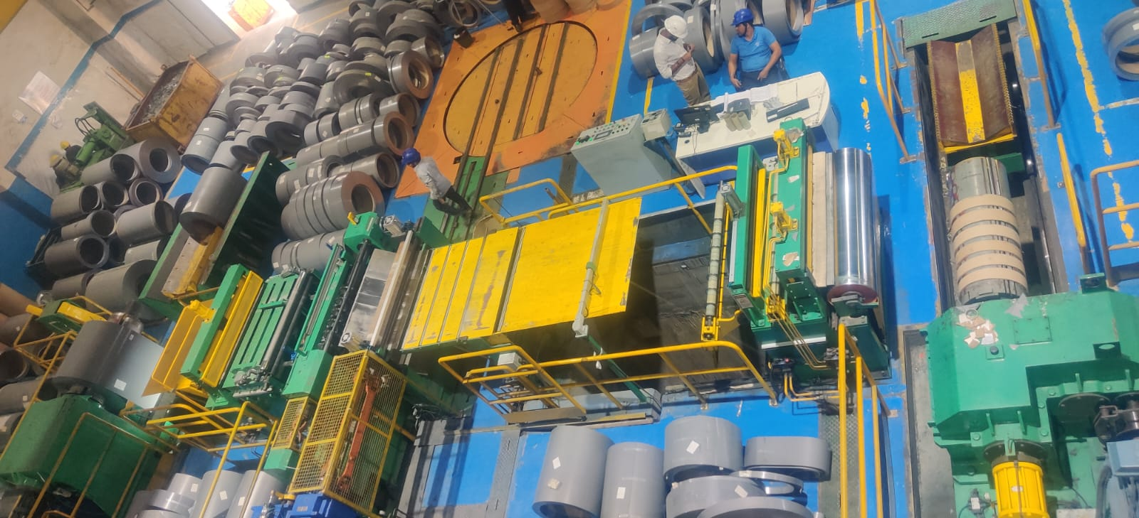

Slide 9
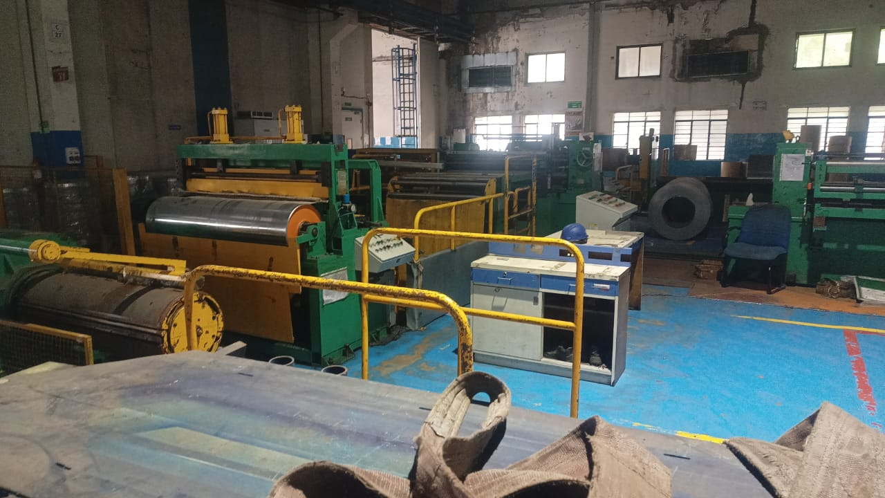

Slide 10
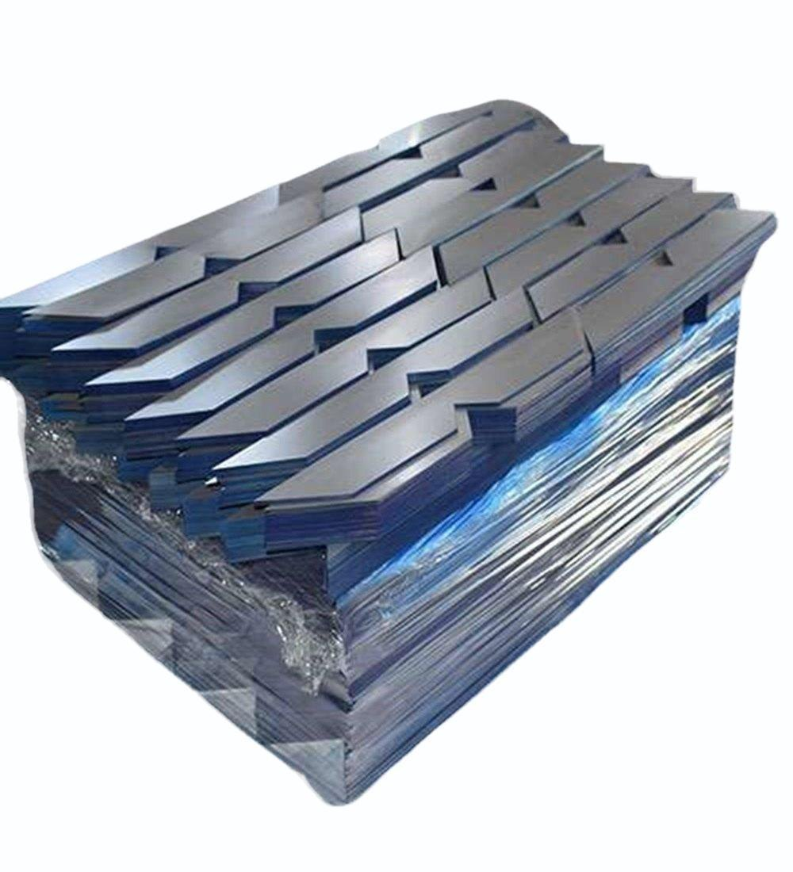
Why Choose Us
Consistent product quality
Competitive pricing
On-time delivery commitment
Customer-focused approach
Reliable after-sales support

Slide 11
Applications
Distribution Transformers
Power Transformers
Industrial Electrical Equipment
Energy and Utility Sector
Electrical Panel Manufacturing

Slide 12

Contact Us
STAMPCORE INDIA PVT. LTD.
M.I.D.C Taloja, Maharashtra, India
Email: infostampcore@gmail.com
Phone: +91-9321252487

